Slide 1



Household Service
A streamlined platform for service management
12202080501001 Alisha Oza
12202080501012 Dhruvi Patel
12202080501015 Diya Patel
1

Slide 2
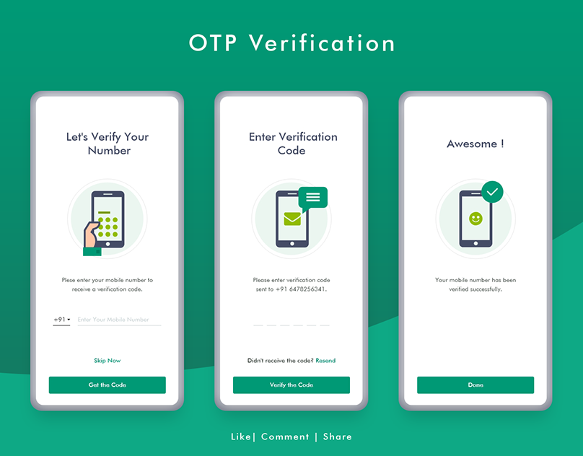
Abstract :
This project focuses on developing a mobile application that enables users to book service providers and confirms the service with OTP verification. The app aims to enhance the booking experience through secure and efficient processes.
2

Slide 3
Modules :
Sign-Up Module: New users can create an account.
Login Module: Existing users can log in to book services.
Booking Module: Users can book services by selecting options.
.Admin Module: Admins manage bookings, service providers, and user feedback.
Service Provider Module: Service providers receive booking details and verify with OTP at the service location.
Notification Module: Sends updates and confirmations to users.
3

Slide 4
TECHNICAL APPROACH :
Frontend Development: HTML, CSS, Bootstrap, VueJS
Backend Development: Flask, SQLAlchemy, Redis, Celery.
Database: SQLite.
Libraries: JWT for security, Flasgger for API documentation, ChartJS for data visualization
Security: Implement secure OTP verification to ensure the integrity of Household Services.
Hosting: Use a cloud service like Firebase or AWS for reliable and scalable hostin
4

Slide 5
FEATURES :
1. User Profiles
Users can create and manage their profiles, view booking history, and receive notifications.
2. Service Booking
A straightforward interface for booking services, with details such as date, time, and service type.
3. OTP Verification
An OTP is sent to the user’s registered phone number to confirm the booking.
4. Admin Control
Admins can view and manage all bookings, ensuring service quality and resolving any issues.
5. Notification System
Users receive real-time updates about their bookings, confirmations, and reminders.
5

Slide 6
CONCLUSION :
The Service Booking App with OTP Verification is designed to enhance the service booking experience by offering a secure and user-friendly platform. Through its intuitive design and robust verification system, the app aims to provide a reliable solution for both users and service providers.
6

Slide 7
Thank you
7

